Slide 1
Collaboration And Governance In Agile EA

Slide 2
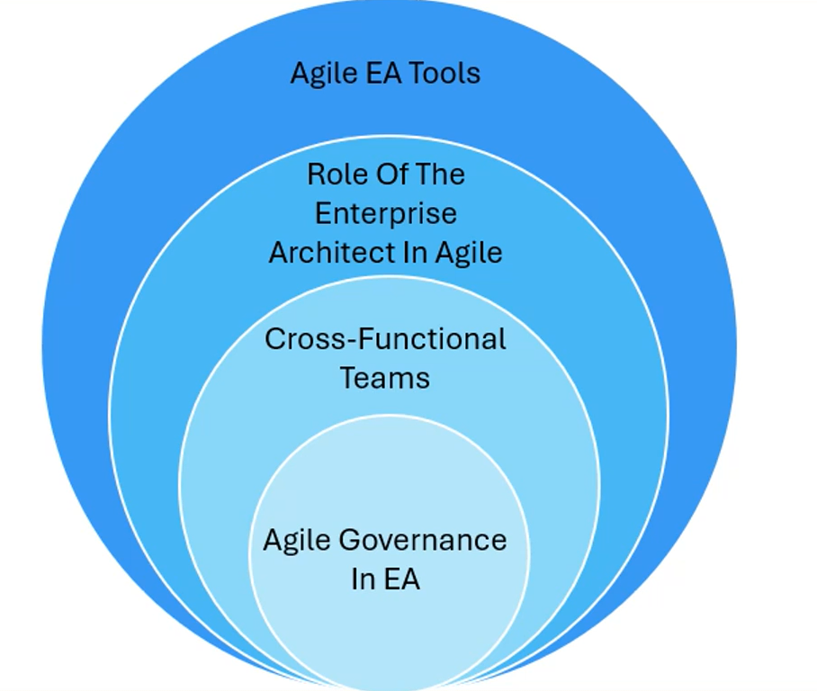
Collaboration And Governance In Agile EA

Slide 3
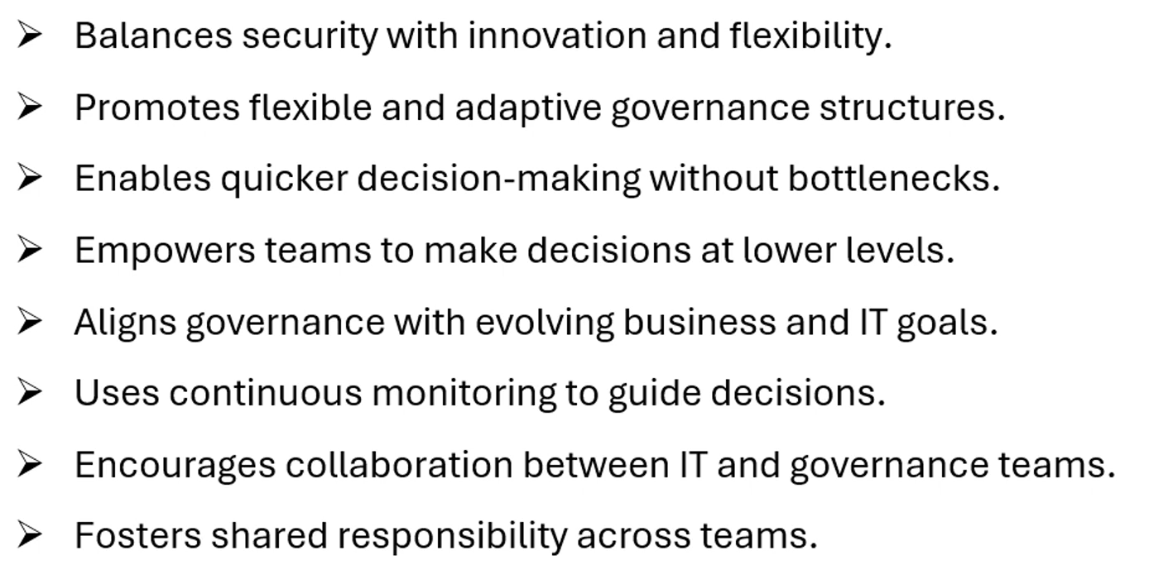
Agile Governance In EA

Slide 4
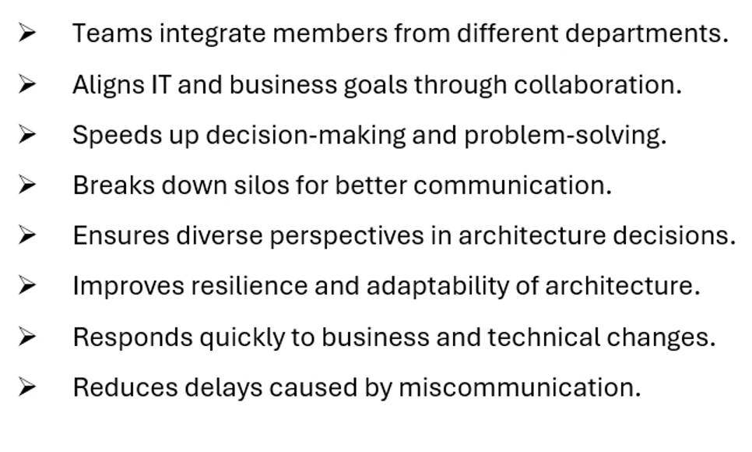
Cross-Functional Teams

Slide 5
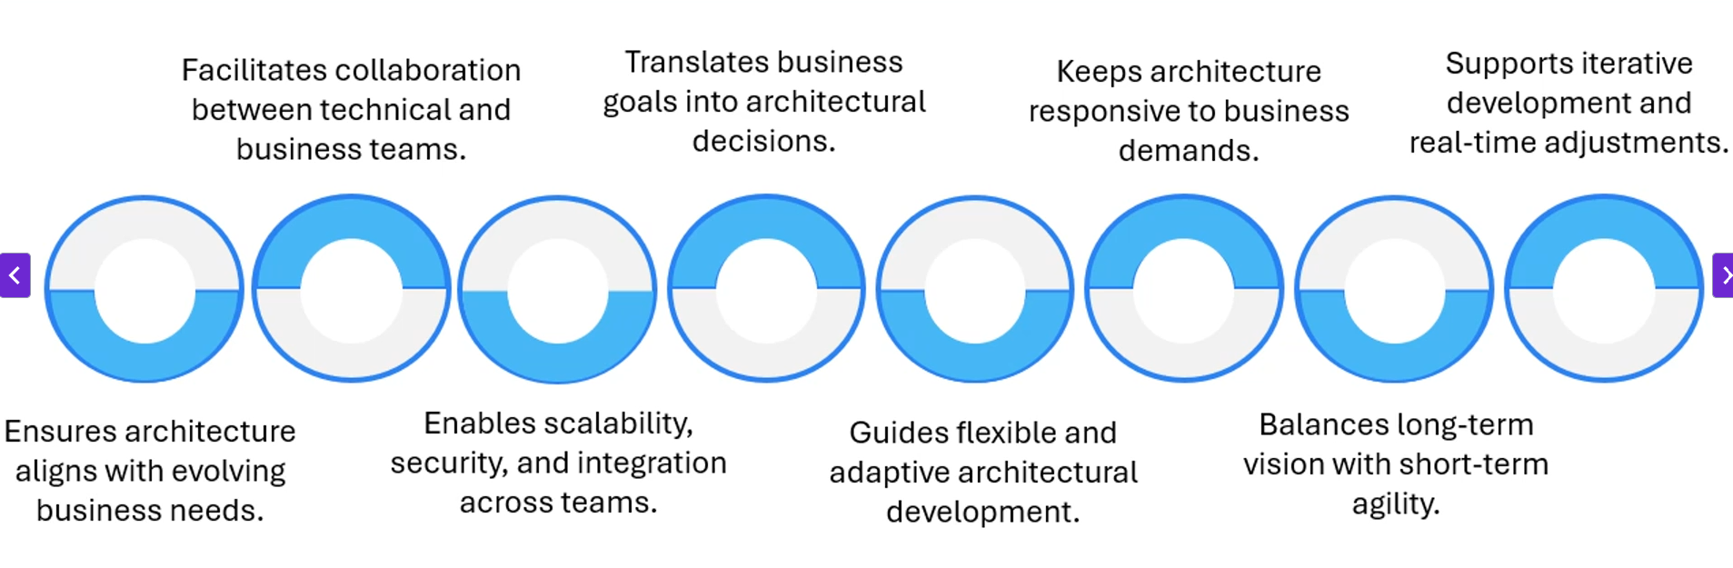
Role Of the Enterprise Architect In Agile

Slide 6
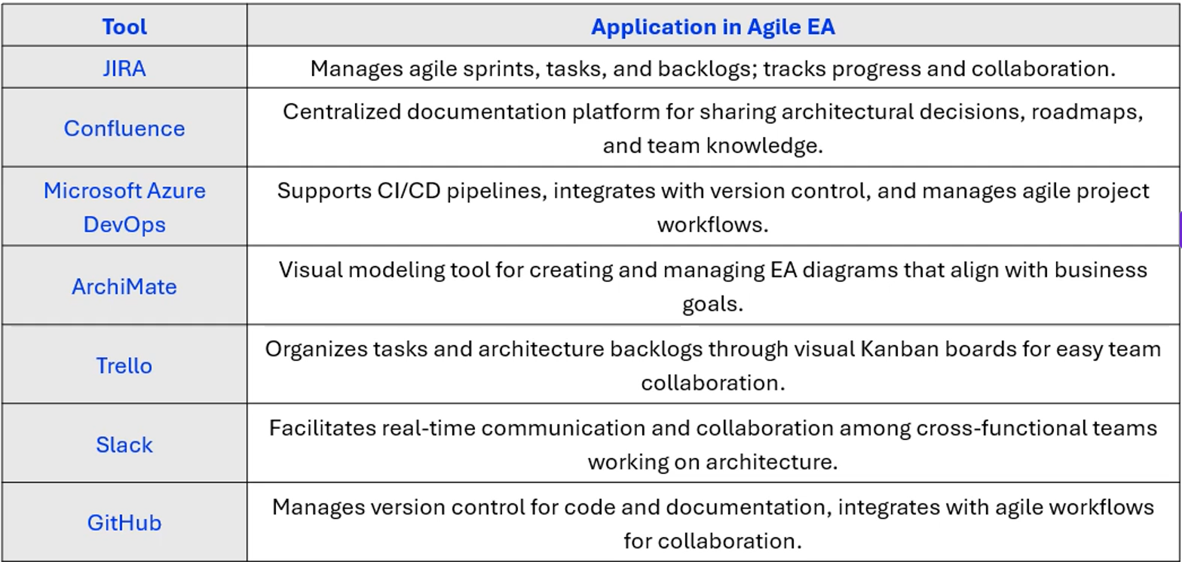
Agile EA Tools

